Slide 1
INVESTIGATE THE MISALIGNMENT BETWEEN POINT CLOUD AND PERSPECTIVE IMAGE
Final Project CS 513 Geospatial Vision/Visualization

Slide 2

TEAM MEMBERS
Adarsh M V – A20424847
Harshitha Rangaswamy – A20400223
Prerna Kumari – A20428292
Rahul Hosmani – A20418527

Slide 3

Requirements
Programming Language: Python
Python libraries:
Math
CV2
Numpy
Pandas
Skimage
Mesh Lab

Slide 4
Input Data
Camera Configuration
Camera Information
Latitude, Longitude, Altitude, Quaternion S, Quaternion X, Quaternion Y, Quaternion Z
Perspective Image
Images from camera. The Field of View (FOV) is 90 degrees (Assuming no distortion).
Front, Back, Left and Right
Point Cloud
Point Cloud Data
Latitude, Longitude, Altitude, Intensity

Slide 5
Objectives
Extract the given information form the input data files
Process the data and perform Coordinate Transformations.
Step 1: LLA to ECEF
Step 2: ECEF to ENU
Step 3: ENU to Camera Coordinates
Step 4: Camera Coordinates to Image Coordinates
Lastly, Calculate the Misalignment angle between the point cloud and the perspective images.
Glossary:
LLA – Latitude Longitude Altitude
ECEF – Earth Centered, Earth Fixed
ENU – East North Up

Slide 6
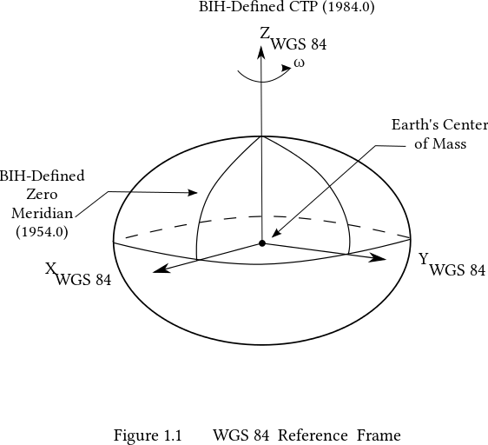
World Geodetic System – Earth Model
Polar Radius = 6356752.3142 m
Equatorial Radius = 6378137 m
WGS 84 (aka WGS 1984, EPSG:4326), established by US Department of Defense in 1984 and last revised in 2004, now being used in Global Positioning System (GPS)

Slide 7
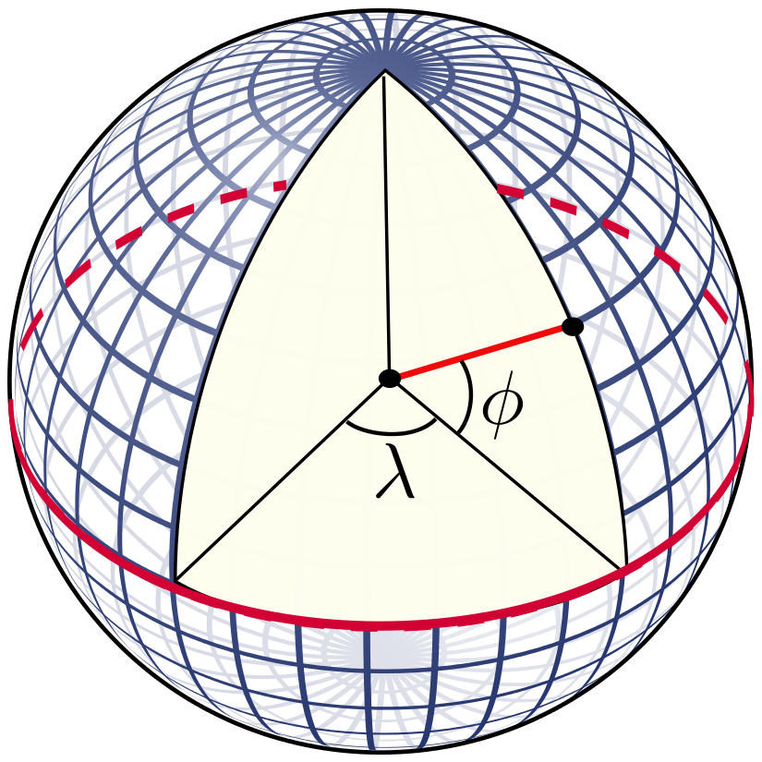
World Geodetic System – Latitude and Longitude
λ = longitude
Φ = geodetic latitude
Flattening of earth ~= 1/298

Slide 8
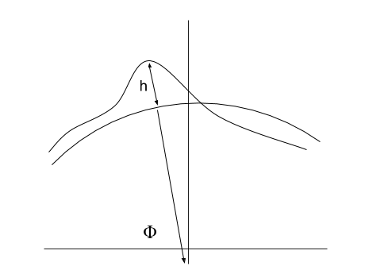
World Geodetic System –Altitude
h – Altitude
Φ – Geodetic Latitude

Slide 9
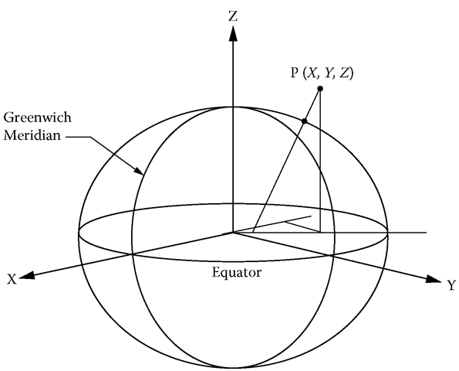
Earth-Centered, Earth-Fixed (ECEF)
A unified geodetic Cartesian coordinate system.
Intermediate step in converting velocities from WGS coordinate to the local tangent coordinate system.

Slide 10
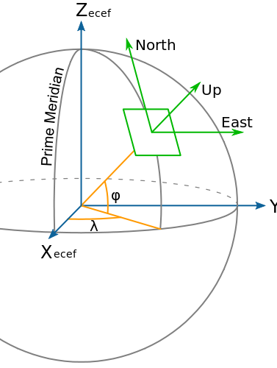
Local Tangent Plane (LTP)
A local Cartesian coordinate system with a given origin.
Also called North East Down (NED), North East Up (NEU), Up North East (UNE)
Intermediate step in converting velocities from WGS coordinate to the camera coordinate system.

Slide 11
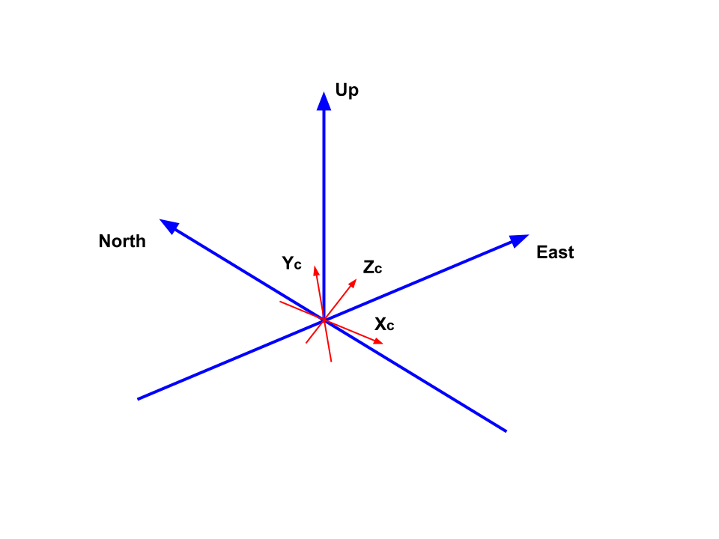
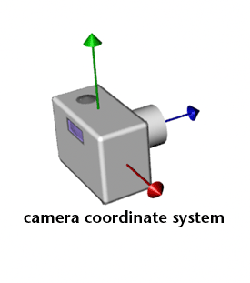
Camera Coordinate
A local Cartesian coordinate system, origin is camera center.
Intermediate step in converting velocities from WGS coordinate to the image coordinate system.

Slide 12
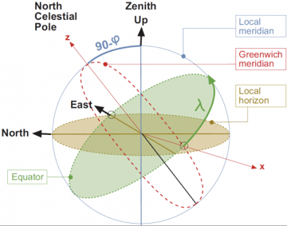
Relation between all the Coordinate Transformations

Slide 13
Point Cloud
A point cloud is a data structure used to represent a collection of multi-dimensional points and is commonly used to represent three-dimensional data.
Points represent the X, Y and Z geometric Coordinates along with the intensity of the point on the sampled surface
These data points are produced by 3D scanners which measure a large number of points on the external surface of the objects around them. It can also be thought as collection of points that represent a 3D shape or feature.

Slide 14
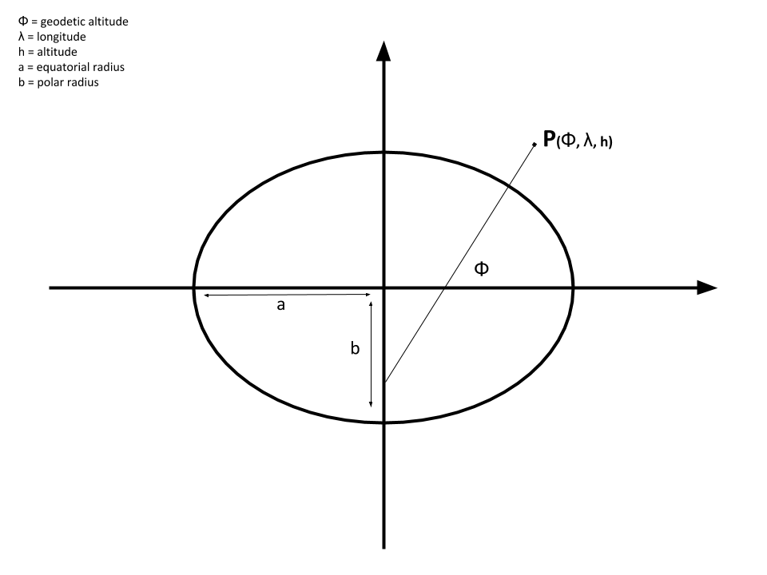
Coordinate Transformations
LLA
ECEF
ENU
Camera Coordinates
Image Coordinates

Slide 15
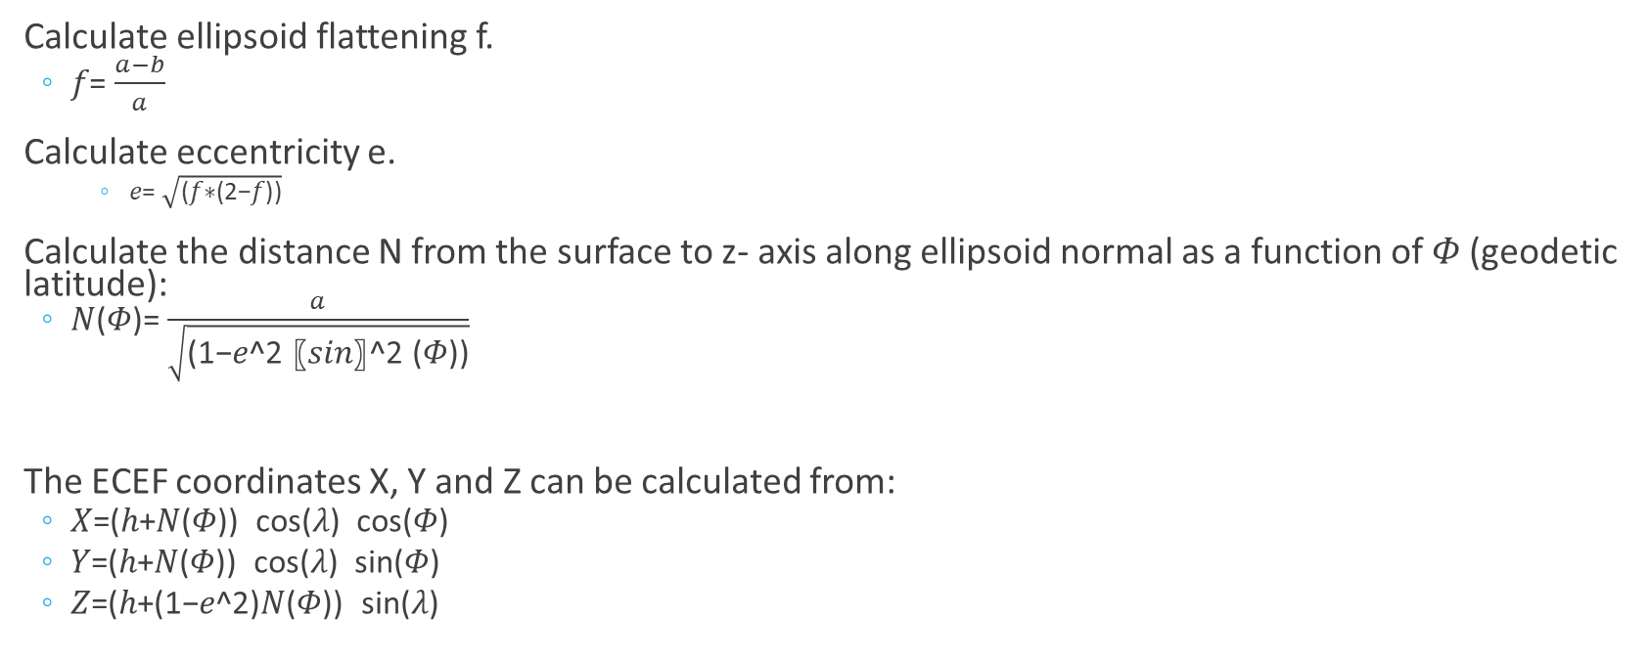
Mathematics: Coordinate Transformation LLA to ECEF
Calculate ellipsoid flattening f.
𝑓= $\frac{a−b}{a}$
Calculate eccentricity e.
𝑒= $\sqrt{\text{(}\text{f}\text{∗(2−}\text{f}\text{))}}$
Calculate the distance N from the surface to z- axis along ellipsoid normal as a function of 𝛷 (geodetic latitude):
𝑁(𝛷)= $\frac{a}{\sqrt{\text{(1−}\text{e}\text{^2 〖}\text{sin}\text{〗^2 (}\text{Φ}\text{))}}}$
The ECEF coordinates X, Y and Z can be calculated from:
𝑋=(ℎ+𝑁(𝛷)) cos⁡(𝜆) cos⁡(𝛷)
𝑌=(ℎ+𝑁(𝛷)) cos⁡(𝜆) sin⁡(𝛷)
𝑍=(ℎ+(1−𝑒^2)𝑁(𝛷)) sin⁡(𝜆)

Slide 16
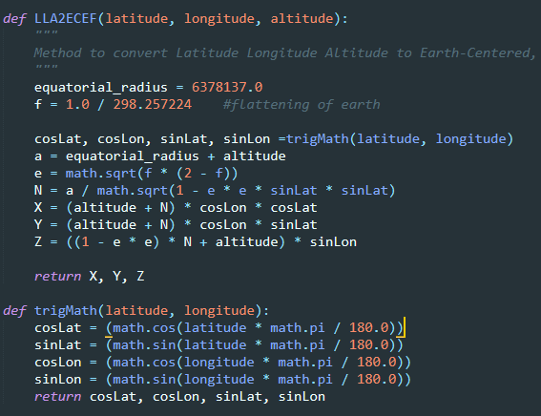
Code Snippet : LLA to ECEF

Slide 17
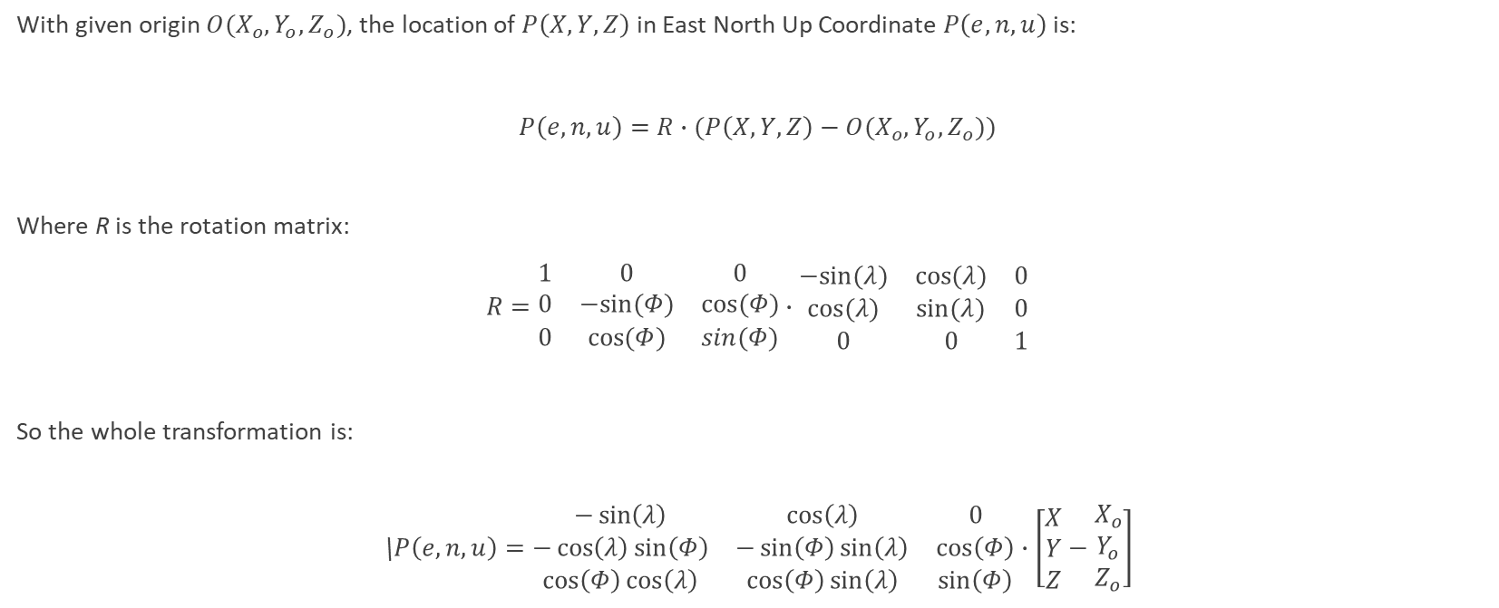
Mathematics: Coordinate Transformation ECEF to ENU
With given origin $O(X_{o},Y_{o},Z_{o})$, the location of $P\left(X,Y,Z\right)$ in East North Up Coordinate $P\left(e,n,u\right)$ is:
$P\left(e,n,u\right)=R∙(P\left(X,Y,Z\right)−O(X_{o},Y_{o},Z_{o}))$
Where R is the rotation matrix:
$R=\begin{matrix}1 & 0 & 0 \\ 0 & −sin⁡(Φ) & cos⁡(Φ) \\ 0 & cos⁡(Φ) & sin(Φ)\end{matrix}∙\begin{matrix}−sin⁡(λ) & cos⁡(λ) & 0 \\ cos⁡(λ) & sin⁡(λ) & 0 \\ 0 & 0 & 1\end{matrix}$
So the whole transformation is:
\$P\left(e,n,u\right)=\begin{matrix}−\sin\left(λ\right) & \cos\left(λ\right) & 0 \\ −\cos\left(λ\right)\sin\left(Φ\right) & −\sin\left(Φ\right)\sin\left(λ\right) & \cos\left(Φ\right) \\ \cos\left(Φ\right)cos\left(λ\right) & \cos\left(Φ\right)\sin\left(λ\right) & \sin\left(Φ\right)\end{matrix}∙\left[\begin{matrix}X \\ Y \\ Z\end{matrix}−\begin{matrix}X_{o} \\ Y_{o} \\ Z_{o}\end{matrix}\right]$

Slide 18
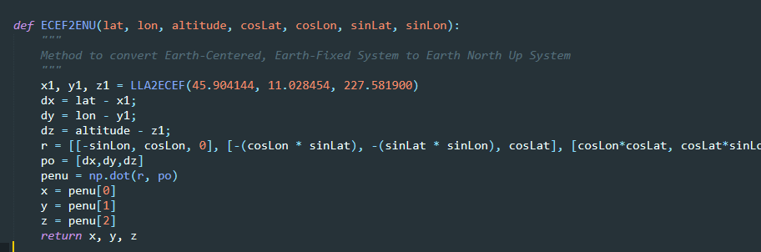
Code Snippet : ECEF to ENU

Slide 19
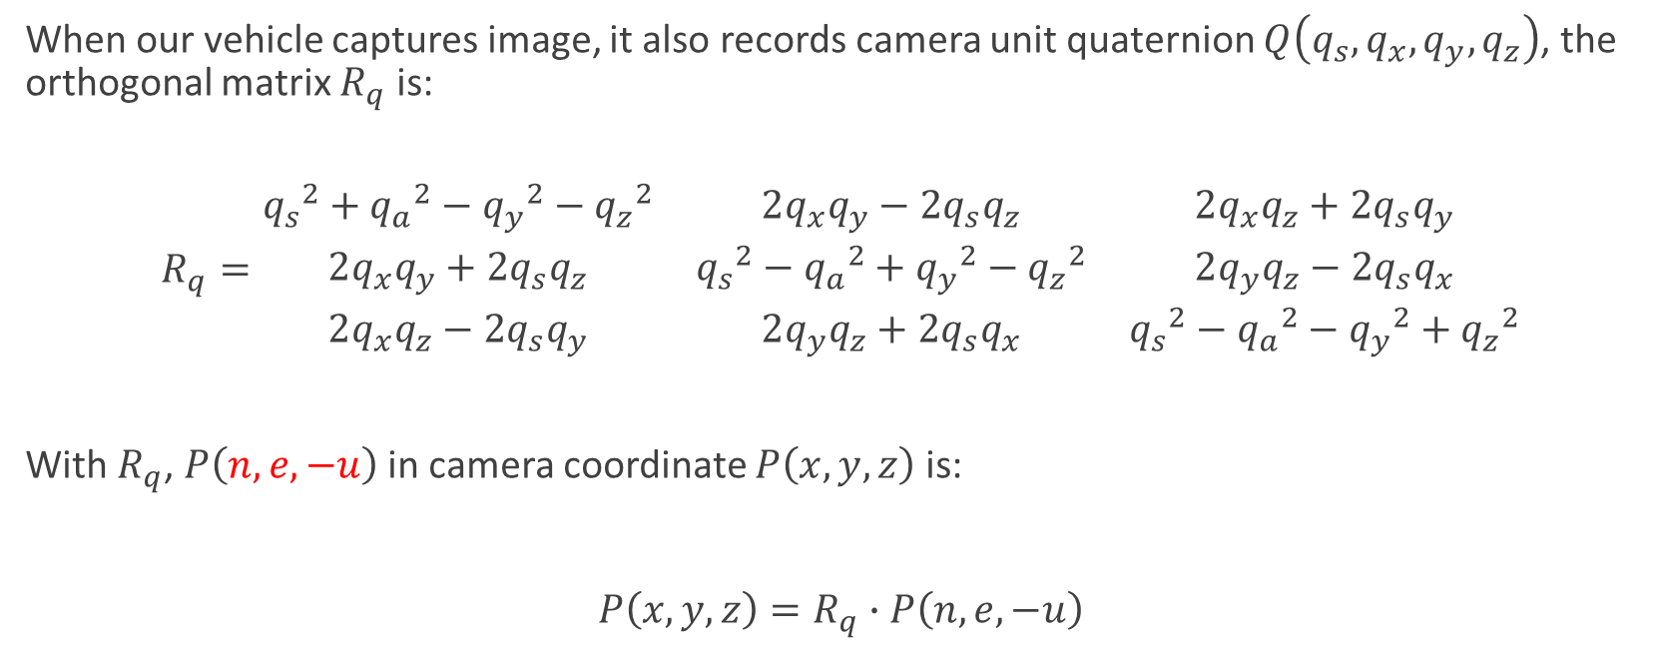
Mathematics: Coordinate Transformation ENU to Camera Coordinates
When our vehicle captures image, it also records camera unit quaternion $Q\left(q_{s},q_{x},q_{y},q_{z}\right)$, the orthogonal matrix $R_{q}$ is:
$R_{q}=\begin{matrix}{q_{s}}^{2}+{q_{a}}^{2}−{q_{y}}^{2}−{q_{z}}^{2} & 2q_{x}q_{y}−2q_{s}q_{z} & 2q_{x}q_{z}+2q_{s}q_{y} \\ 2q_{x}q_{y}+2q_{s}q_{z} & {q_{s}}^{2}−{q_{a}}^{2}+{q_{y}}^{2}−{q_{z}}^{2} & 2q_{y}q_{z}−2q_{s}q_{x} \\ 2q_{x}q_{z}−2q_{s}q_{y} & 2q_{y}q_{z}+2q_{s}q_{x} & {q_{s}}^{2}−{q_{a}}^{2}−{q_{y}}^{2}+{q_{z}}^{2}\end{matrix}$
With $R_{q}$, $P\left(n,e,−u\right)$ in camera coordinate $P\left(x,y,z\right)$ is:
$P\left(x,y,z\right)=R_{q}∙P\left(n,e,−u\right)$

Slide 20
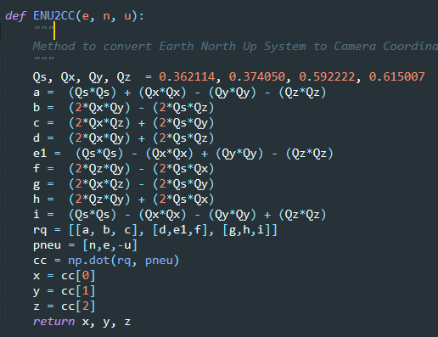
Code Snippet : ENU to Camera Coordinates

Slide 21
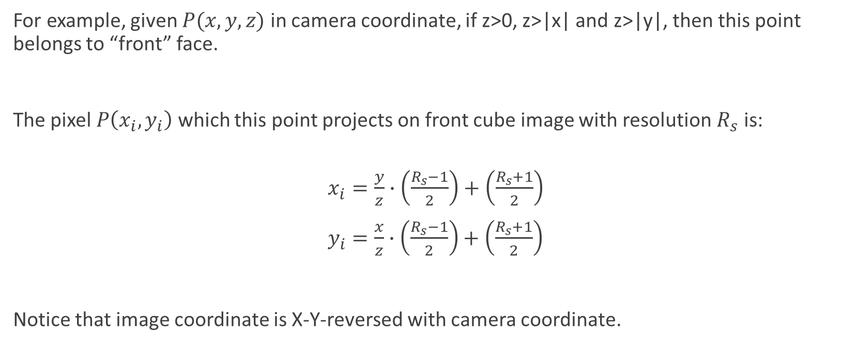
Mathematics: Coordinate Transformation Camera Coordinates to Image Coordinates
For example, given $P(x,y,z)$ in camera coordinate, if z>0, z>|x| and z>|y|, then this point belongs to “front” face.
The pixel $P\left(x_{i},y_{i}\right)$ which this point projects on front cube image with resolution $R_{s}$ is:
$x_{i}=\frac{y}{z}∙\left(\frac{R_{s}−1}{2}\right)+\left(\frac{R_{s}+1}{2}\right)$
$y_{i}=\frac{x}{z}∙\left(\frac{R_{s}−1}{2}\right)+\left(\frac{R_{s}+1}{2}\right)$
Notice that image coordinate is X-Y-reversed with camera coordinate.

Slide 22
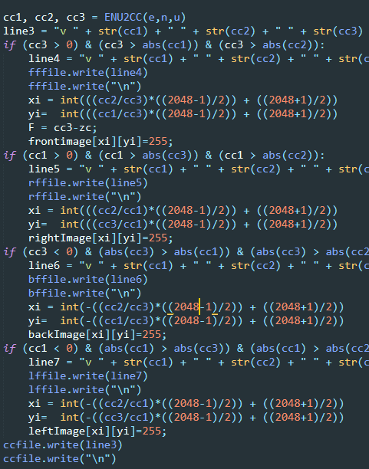
Code Snippet : Camera Coordinates to Image Coordinates

Slide 23
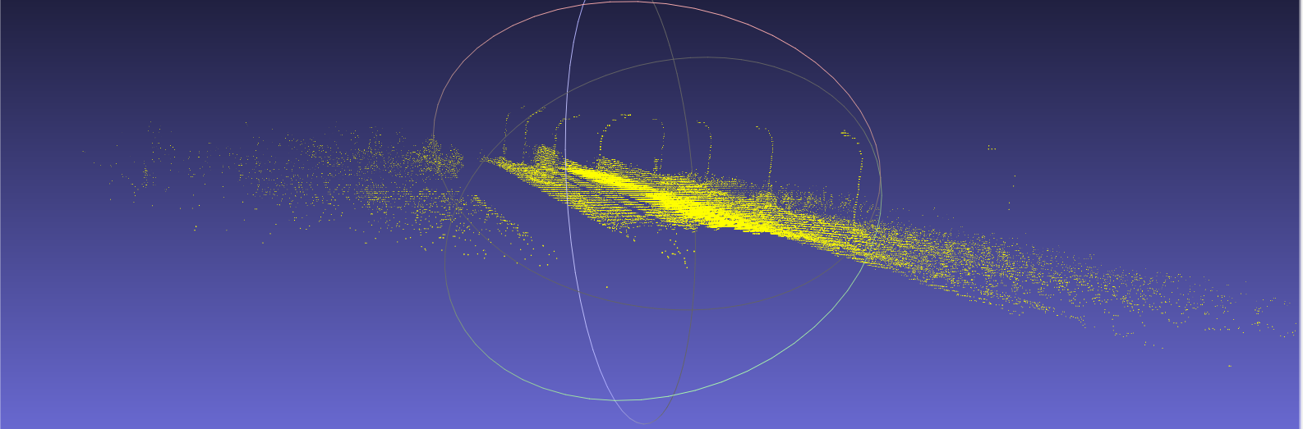
Point Cloud Visualization using MeshLab

Slide 24
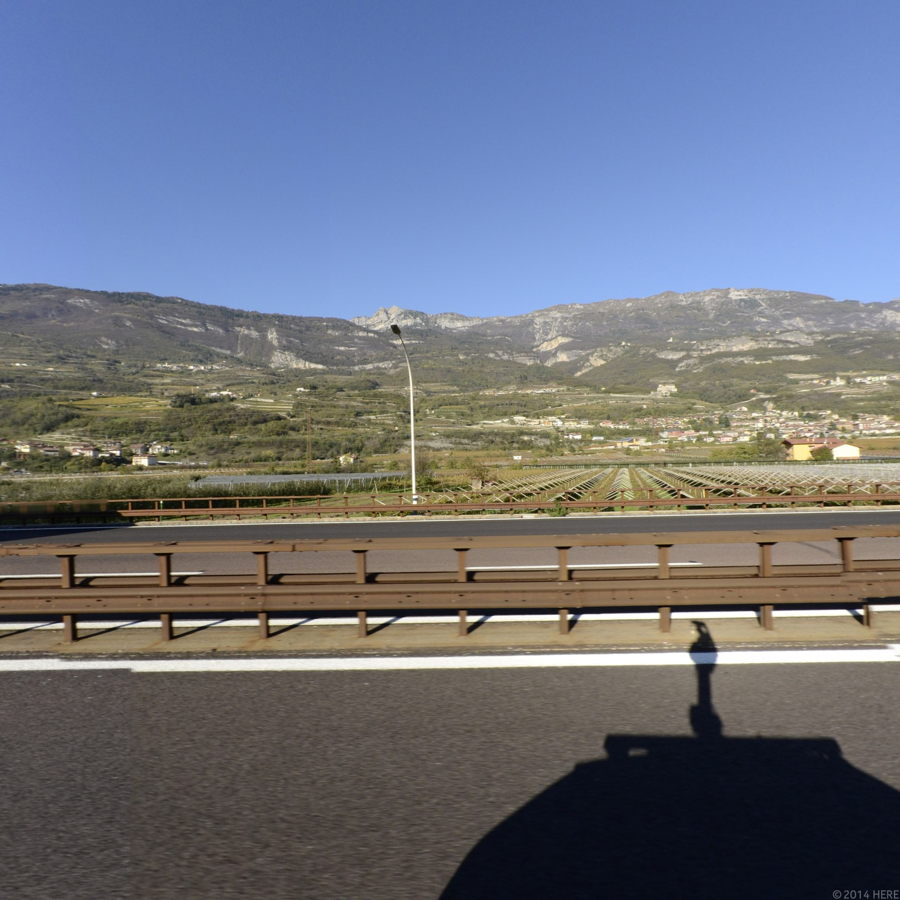
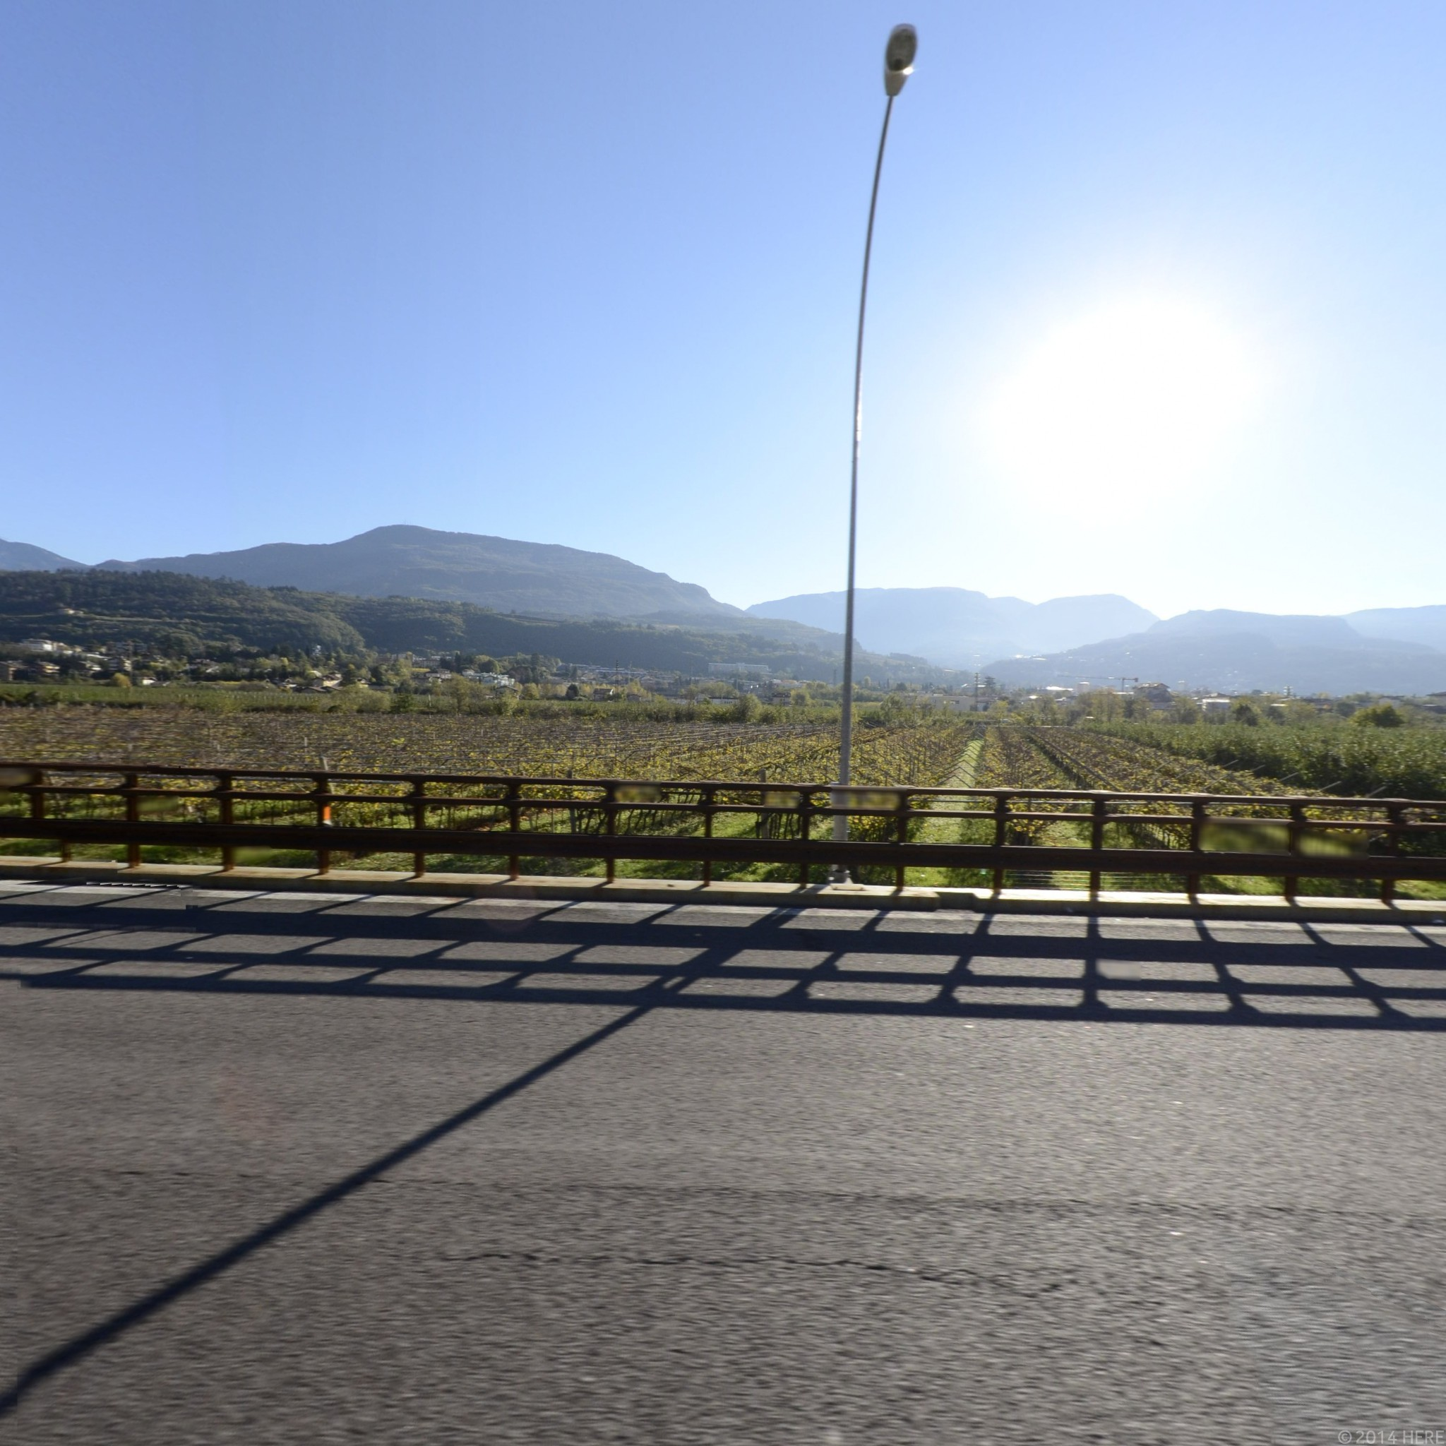
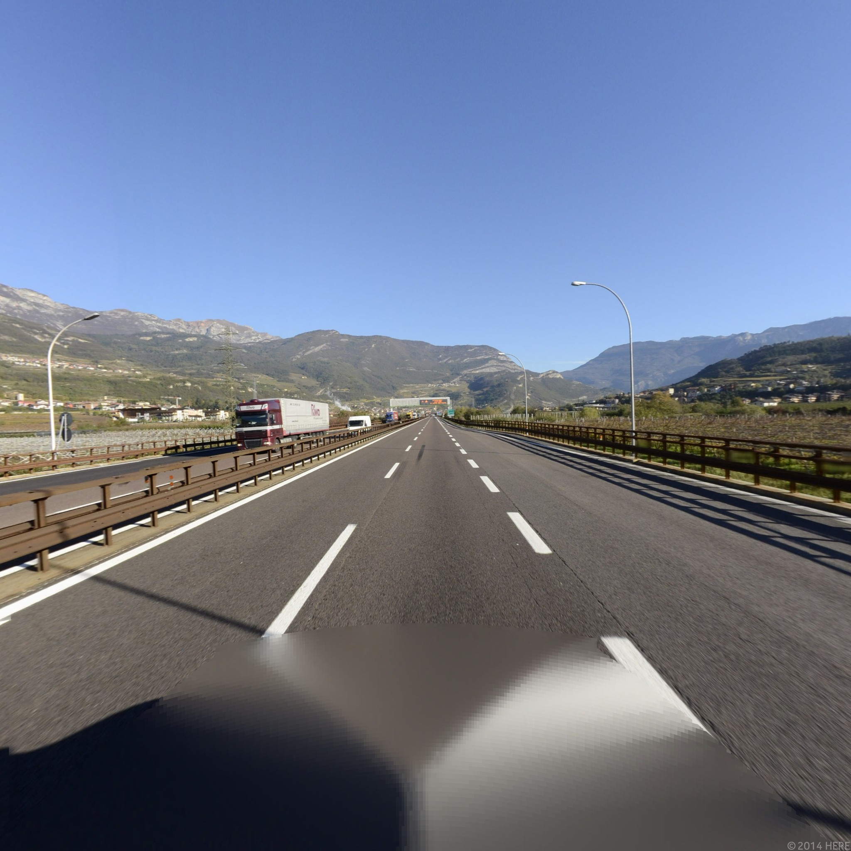
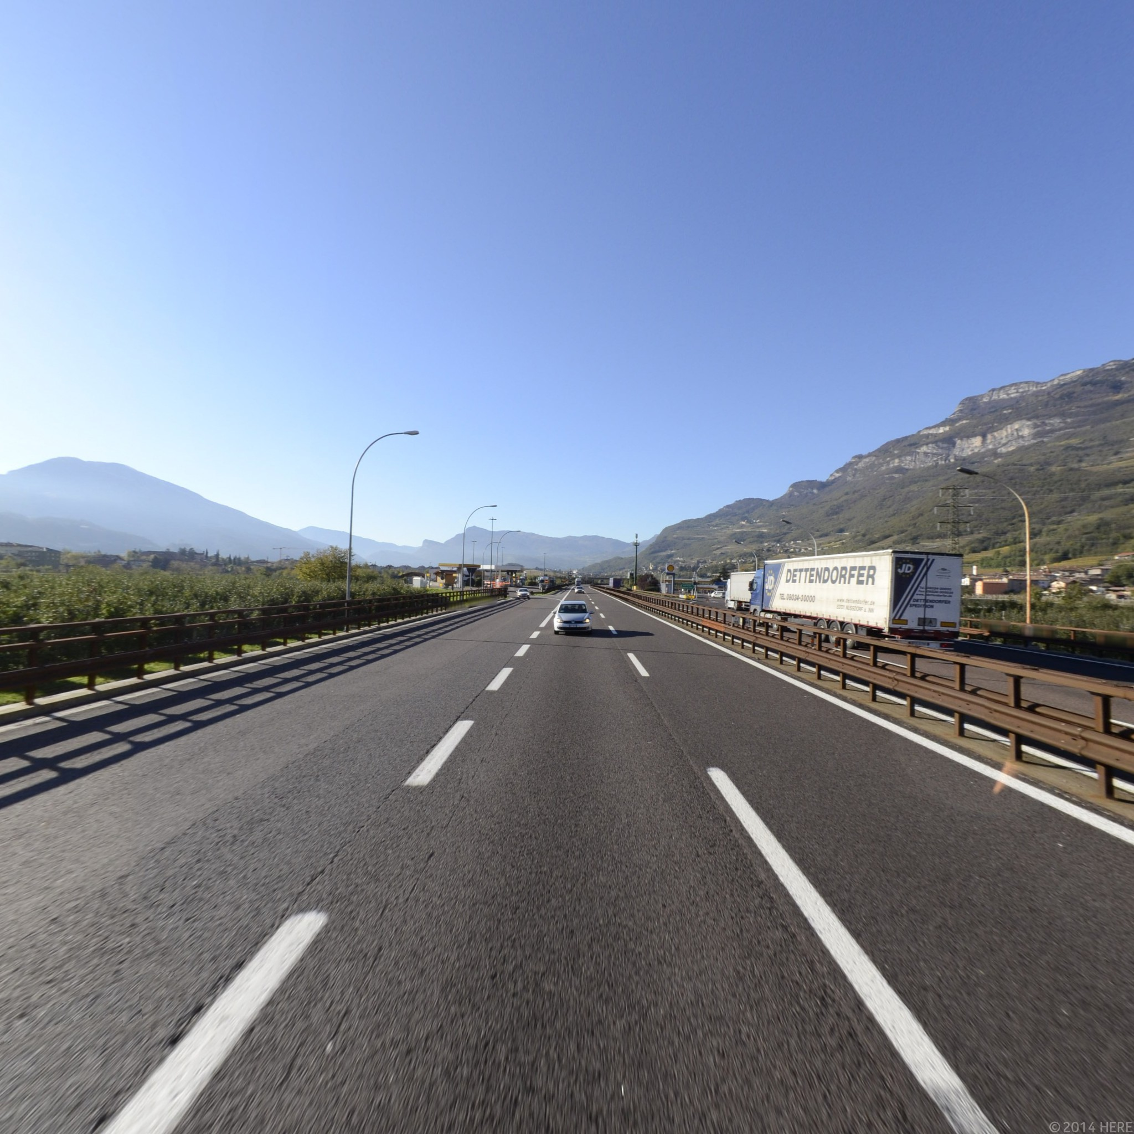
Perspective Images
Left Right Front and Back

Slide 25

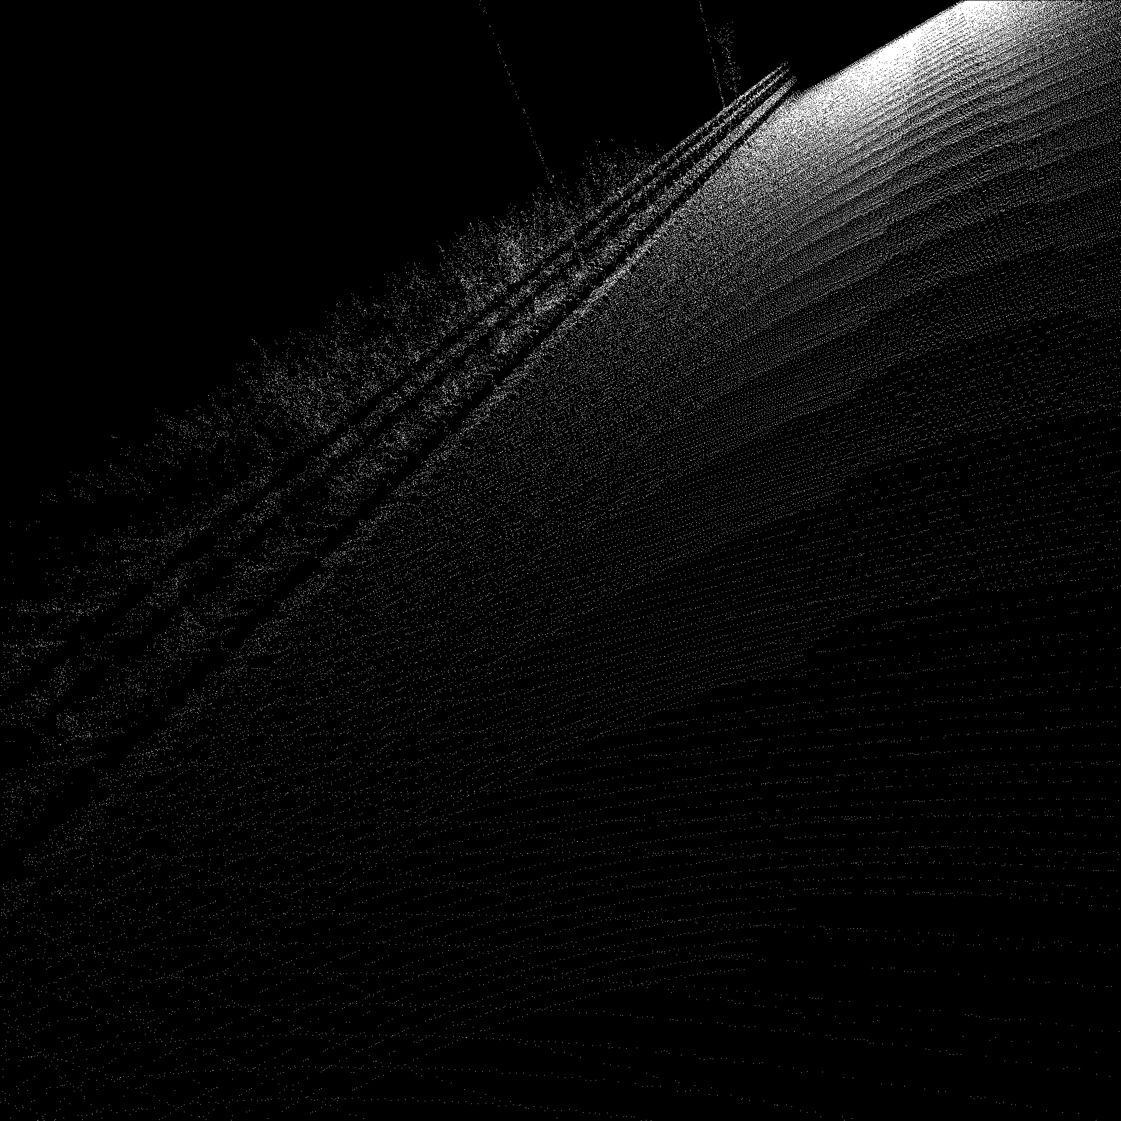
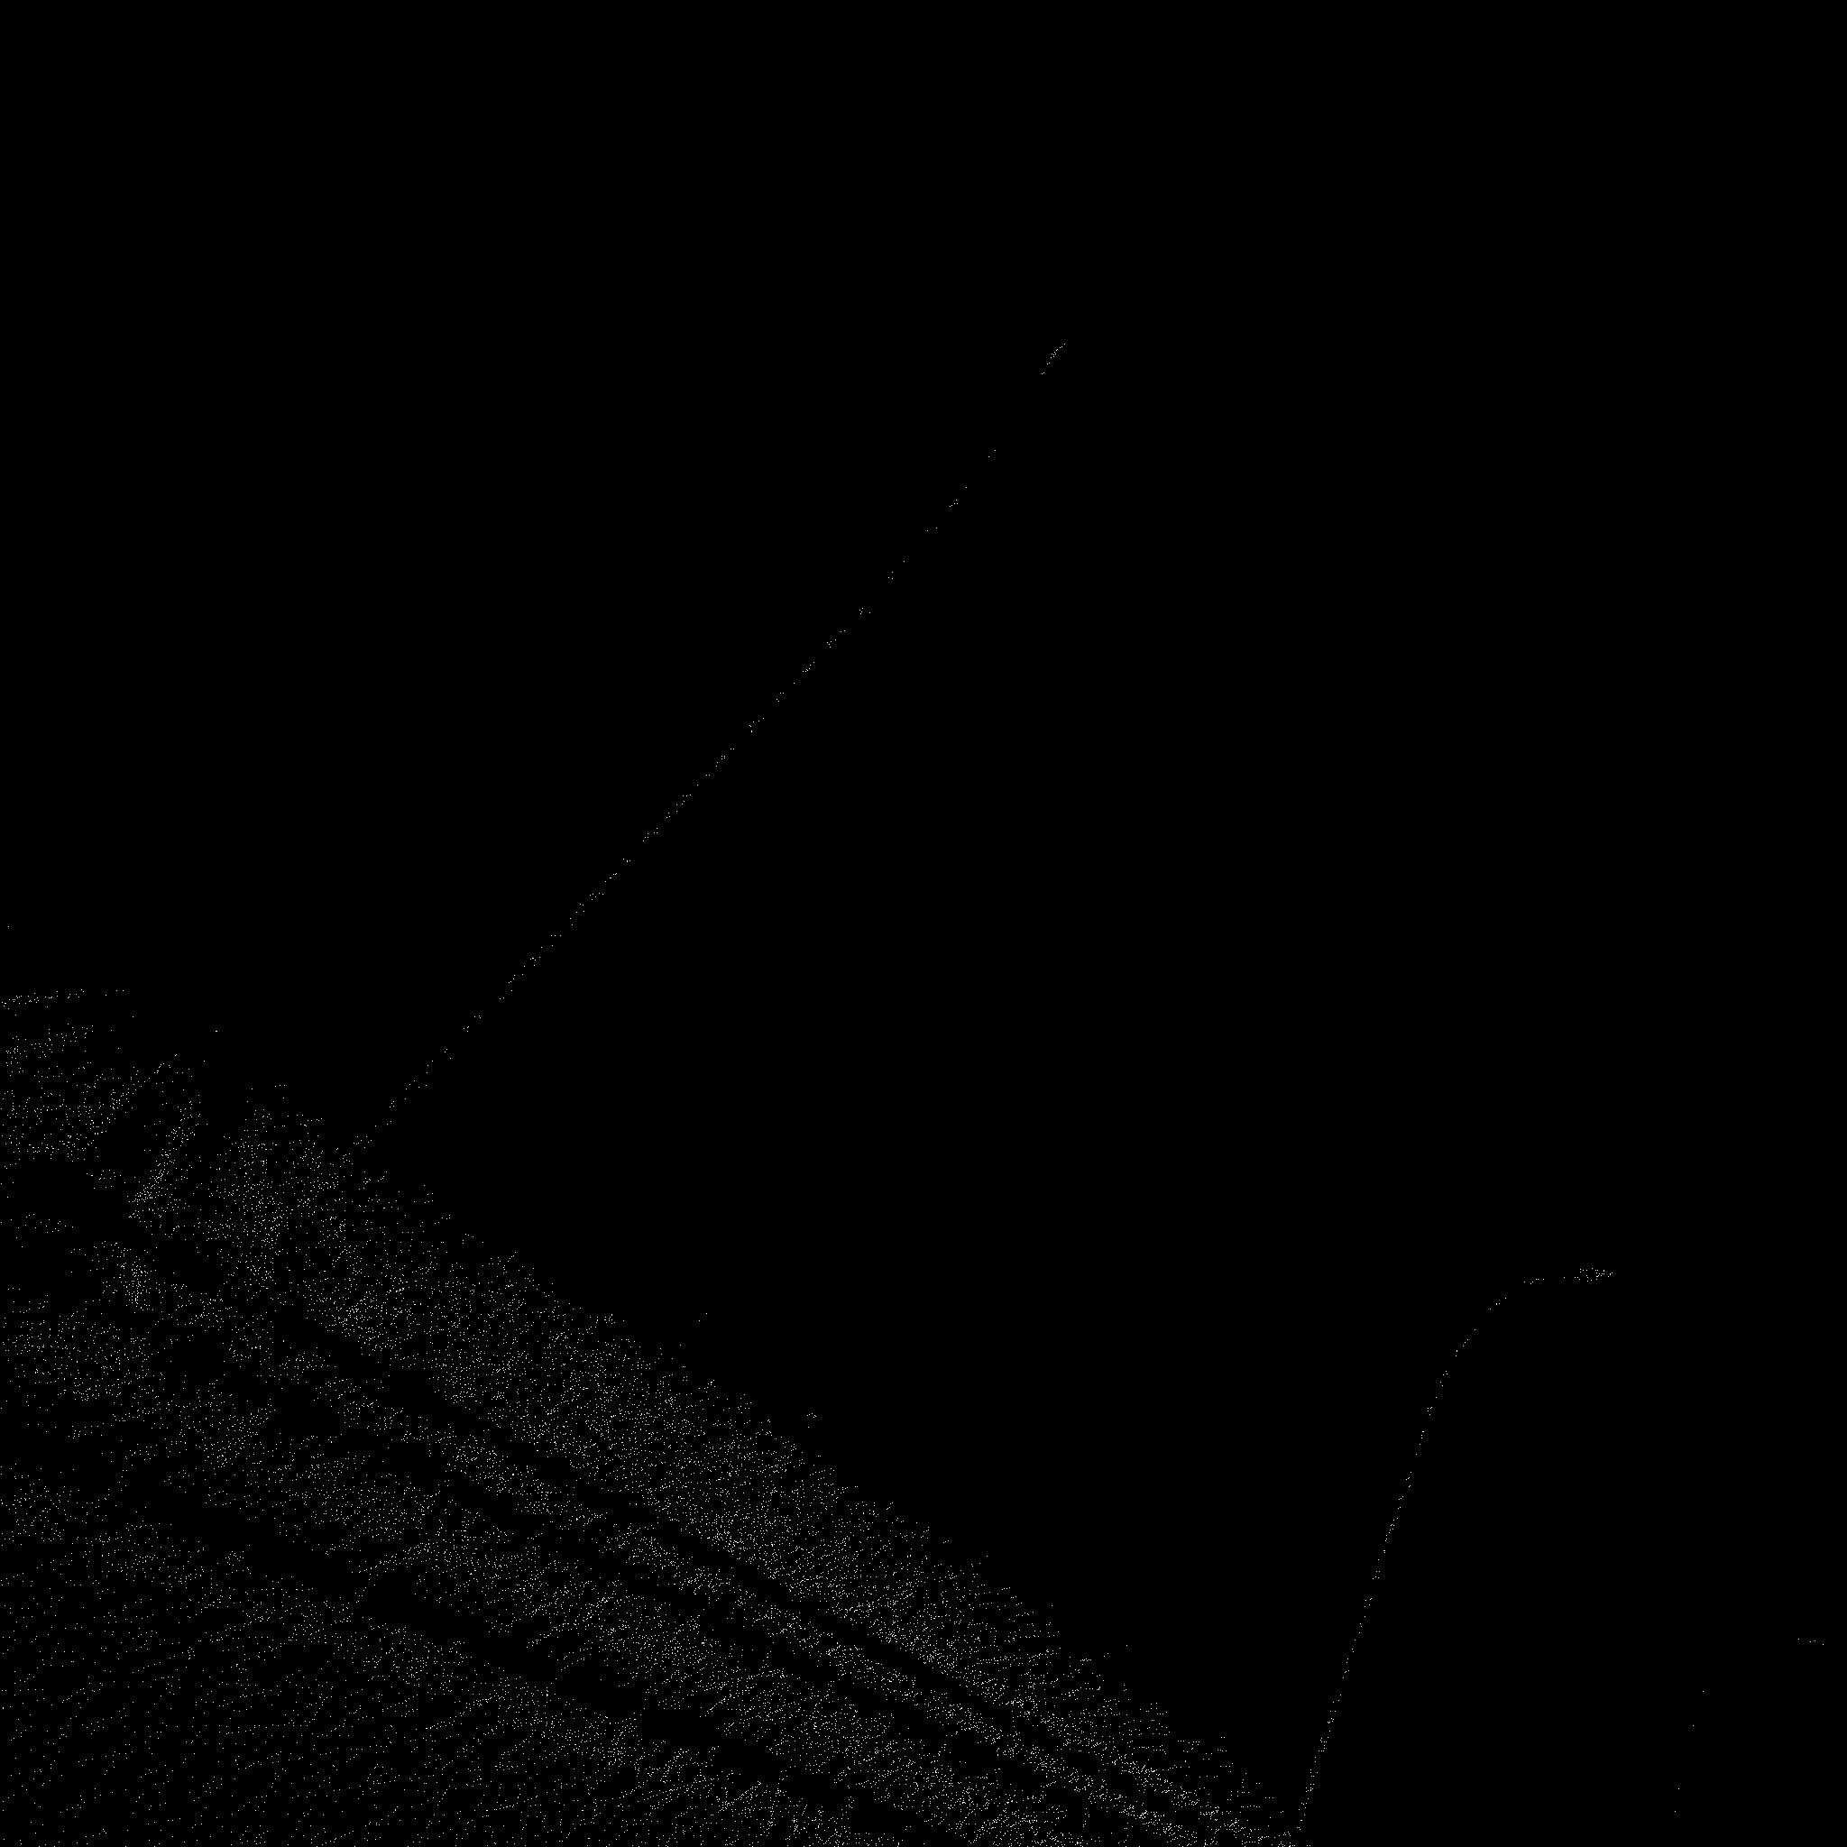
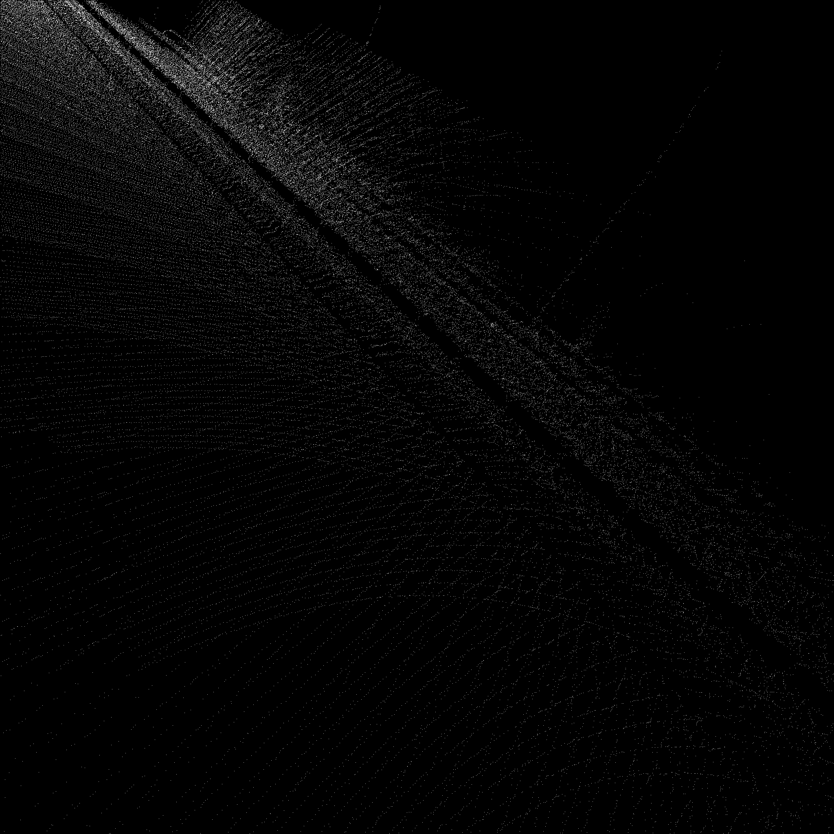
Point cloud of the perspective images after Transformation
Front Back Left Right

Slide 26
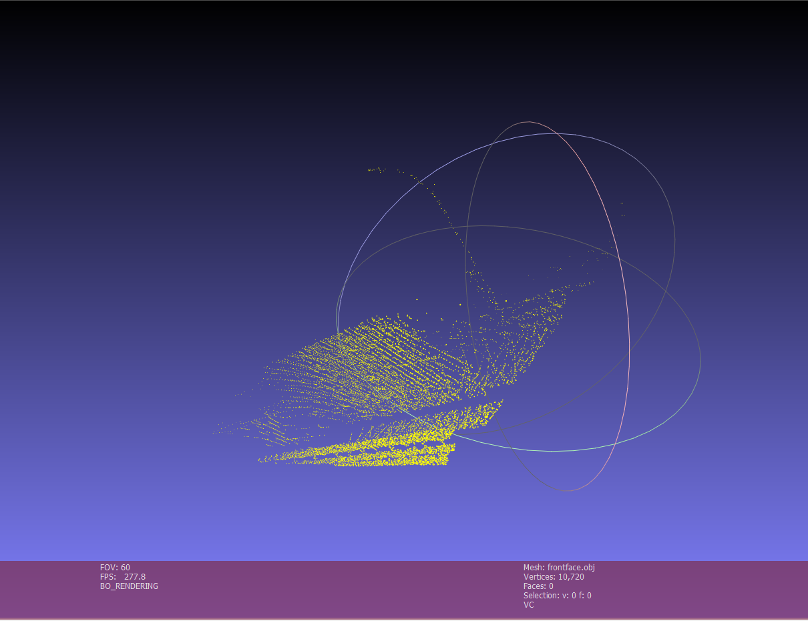
Front Face of the Cube Point Cloud Mesh

Slide 27
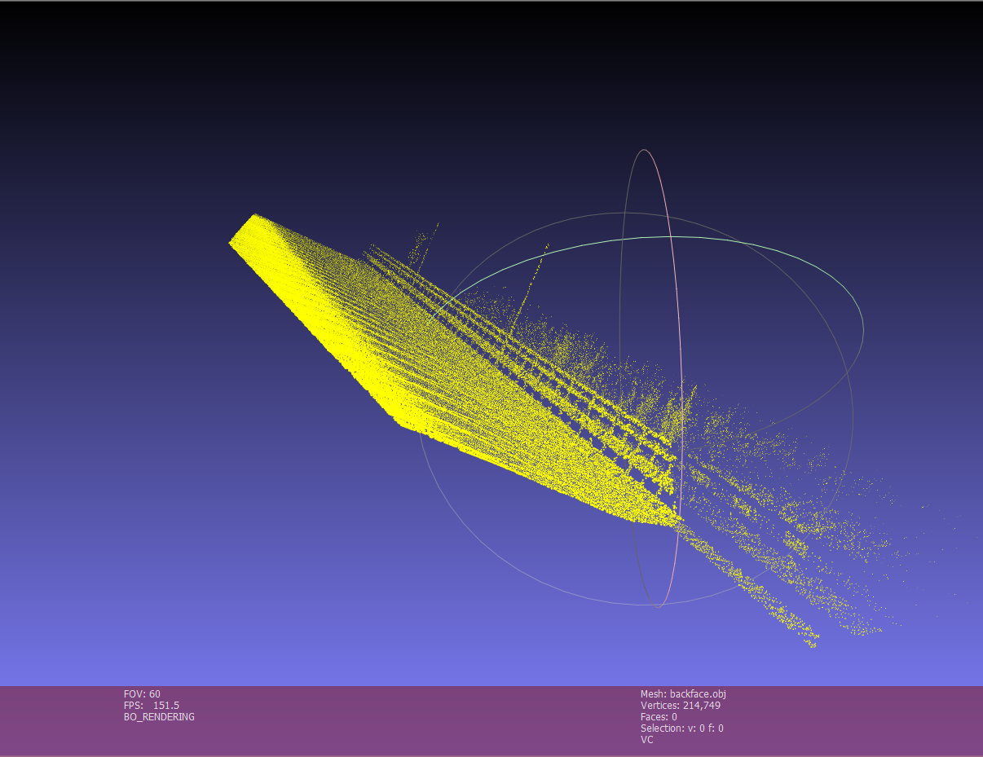
Back Face of the Cube Point Cloud Mesh

Slide 28
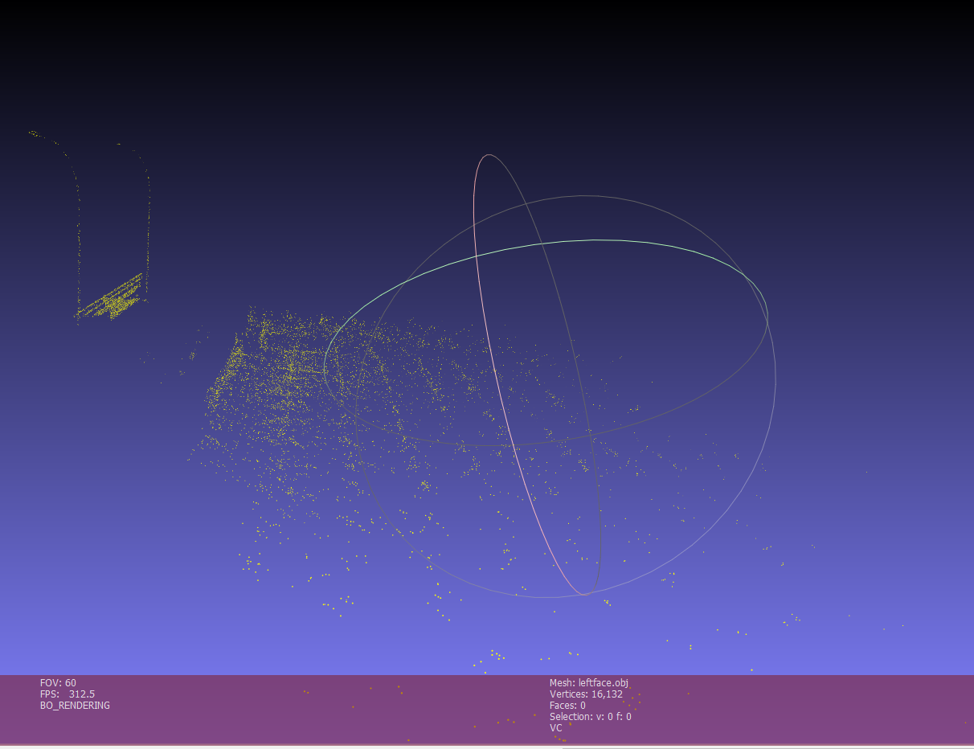
Left Face of the Cube Point Cloud Mesh

Slide 29
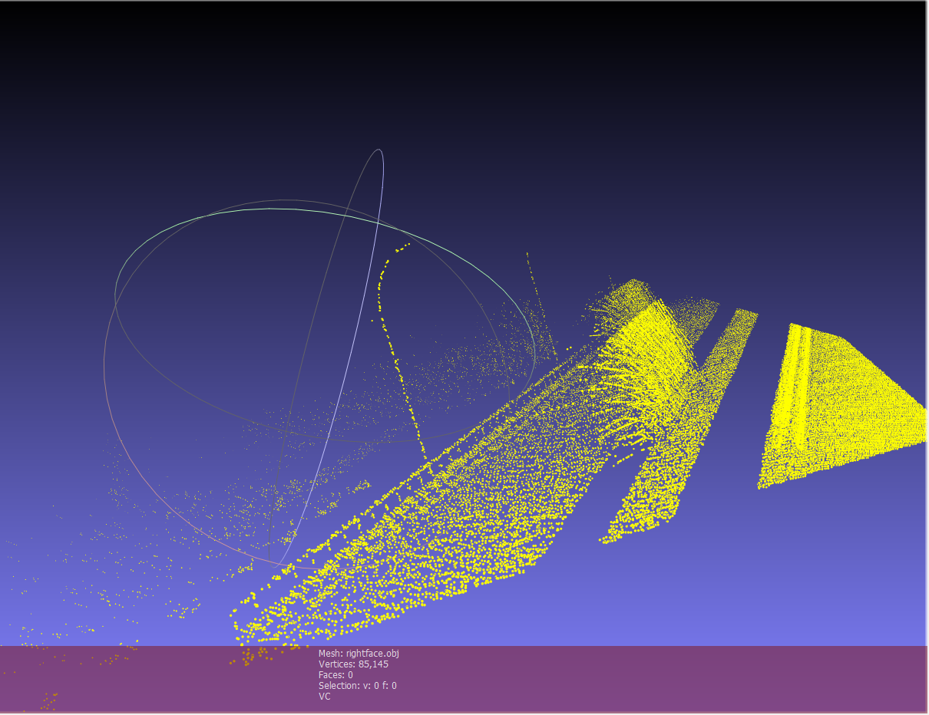
Right Face of the Cube Point Cloud Mesh

Slide 30

Finding the misalignment between point cloud image and camera image
We have used the Brute-Force matcher with SIFT descriptors and Ratio test in OpenCV
Brute-Force matcher is simple. It takes the descriptor of one feature in first set and is matched with all other features in second set using some distance calculation. And the closest one is returned.

Slide 31
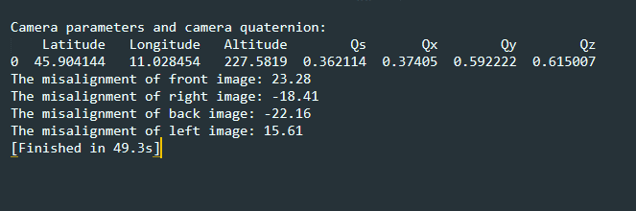
Results

Slide 32

Future Work
In this project, we use feature-based technique to investigate the misalignment between point cloud and perspective image. However, we found that the feature-based approach is not very intuitive and the result may changes with the extraction of different feature points. So in future work, we want to use direct-based technique to investigate the misalignment.

Slide 33
References
https://gssc.esa.int/navipedia/index.php/Transformations_between_ECEF_and_ENU_coordinates
http://docs.opencv.org/trunk/dc/dc3/tutorial_py_matcher.html
https://ww2.mathworks.cn/help/map/ref/ecef2enu.html
https://www.programcreek.com/python/example/89342/cv2.drawMatchesKnn

Slide 34
Thank you

